Slide 1


Welcome
To
Game Zone

Slide 2

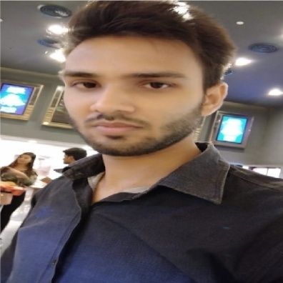
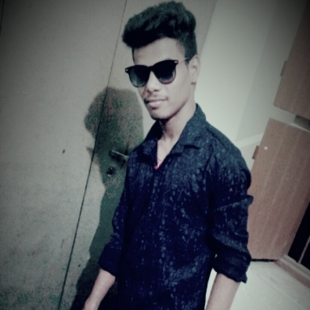
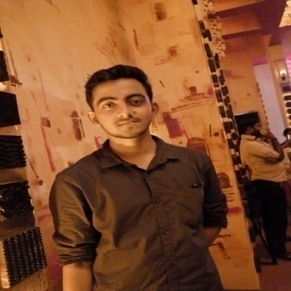
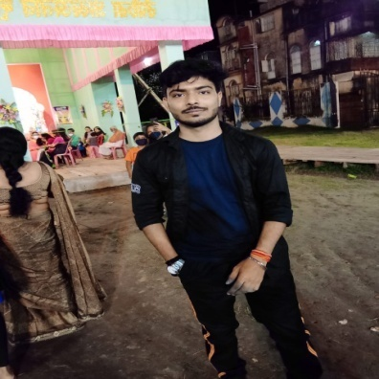
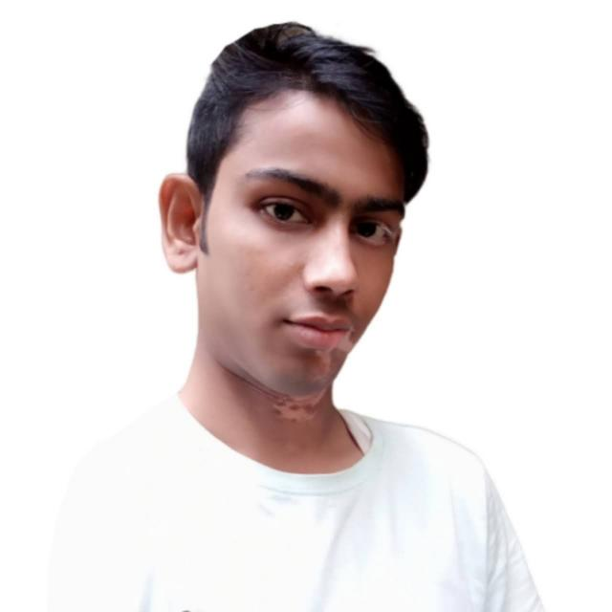
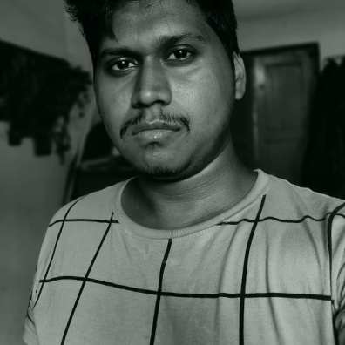
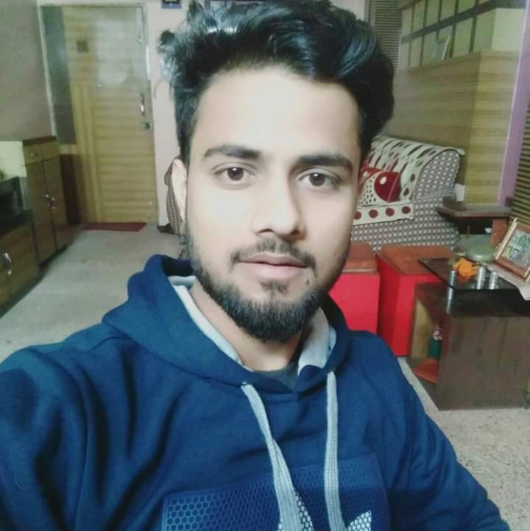
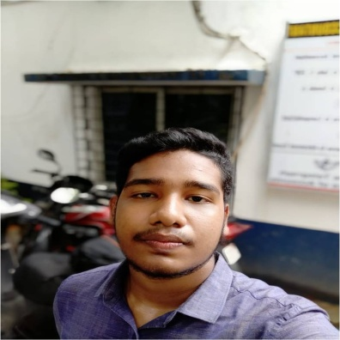
Group Members
Saurabh Jha
(23)
Sahil Gaurav
(27)
Bekrom Roy
(59)
[ Leader ]
Anurag Singh
(67)
Malik Kumar
(46)
Harikesh Kori
(53)
Amritanshu Singh
(73)
Naveen Ray
(41)

Slide 3

PURPOSE
To make your boring life a bit interesting
To provide a fun and social form of entertainment
Increase children’s self-confidence and self-esteem as they master games
To improving hand-eye co-ordination skills

Slide 4


Languages and Framework
HTML5
MYSQL
CSS
BOOTS
TRAP
PHP
JQUERY
UI
JAVA
SCRIPT
JQUERY

Slide 5
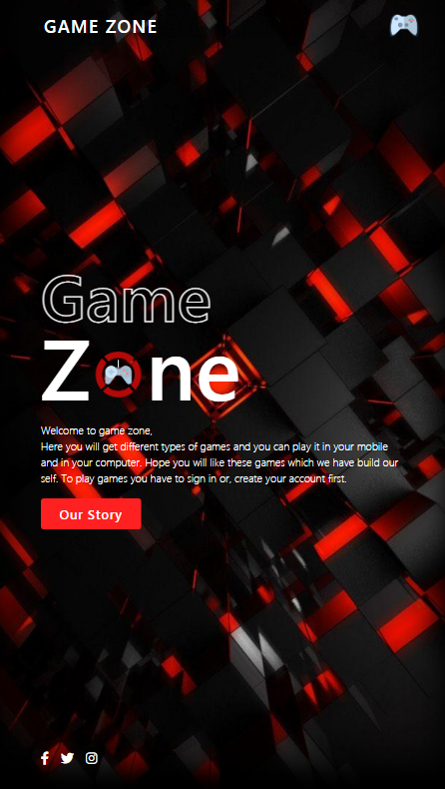
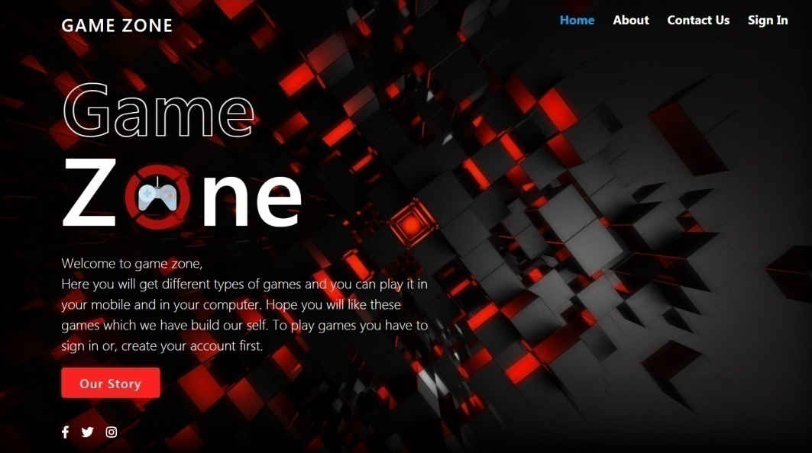
Home Page
Here you will get different types of games and you can play it in your mobile and in your computer. Hope you will like these games which we have build our self. To play games you have to sign in or, create your account first.

Slide 6
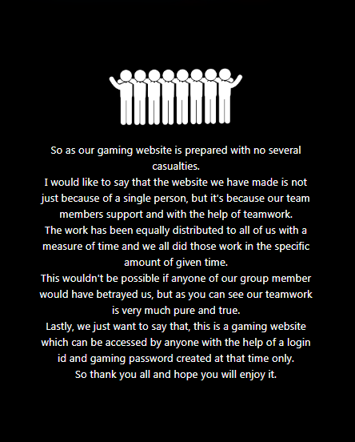
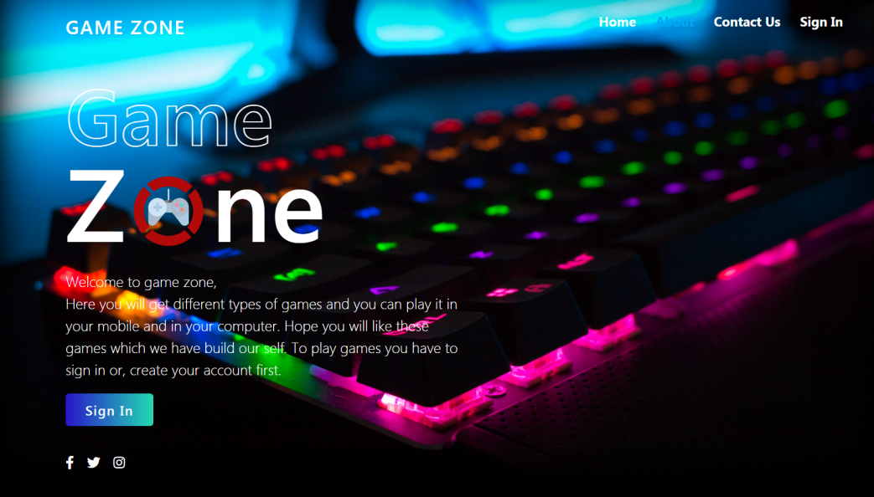
About Us Page
A dream not to make the best gaming website but to make life a bit interesting through our website. We, student daily face study related issues and have lots of pressure about grades, career etc. which sometimes make us feel mentally low and depressed. So we thought to create this website to get some entertainment and keep our mind healthy.

Slide 7
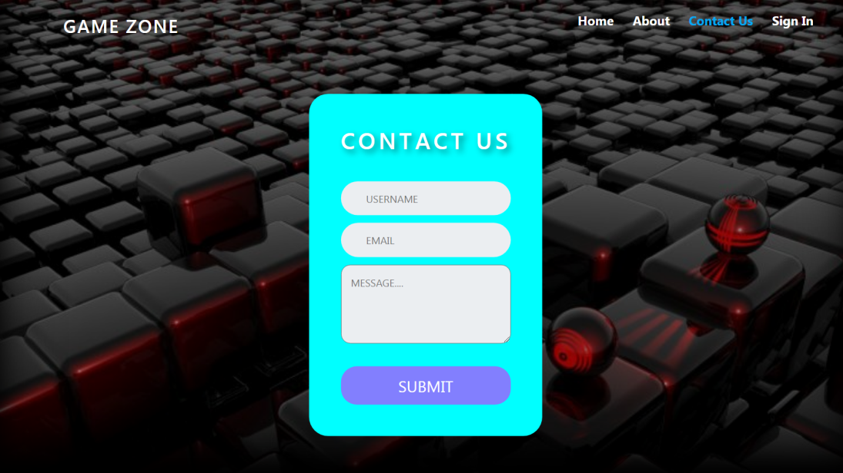
Contact Us Page
If users face any problem during accessing our website or games. They can easily reach through this page…

Slide 8
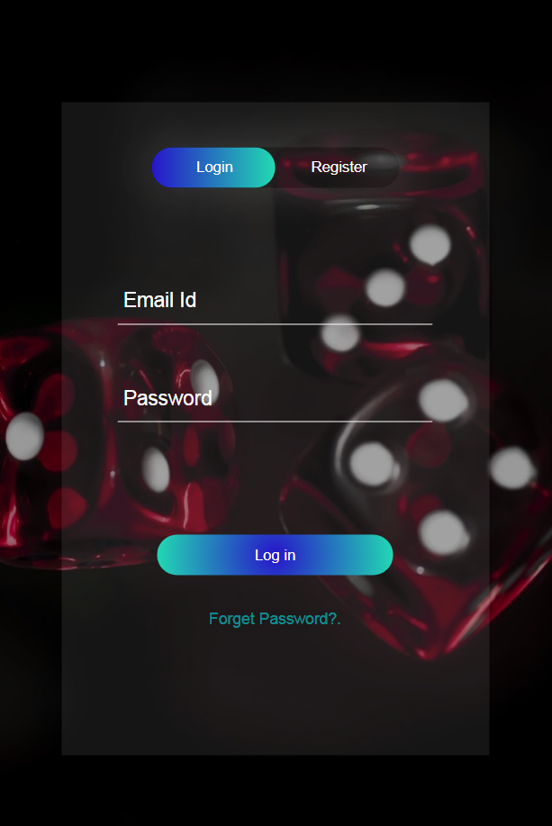
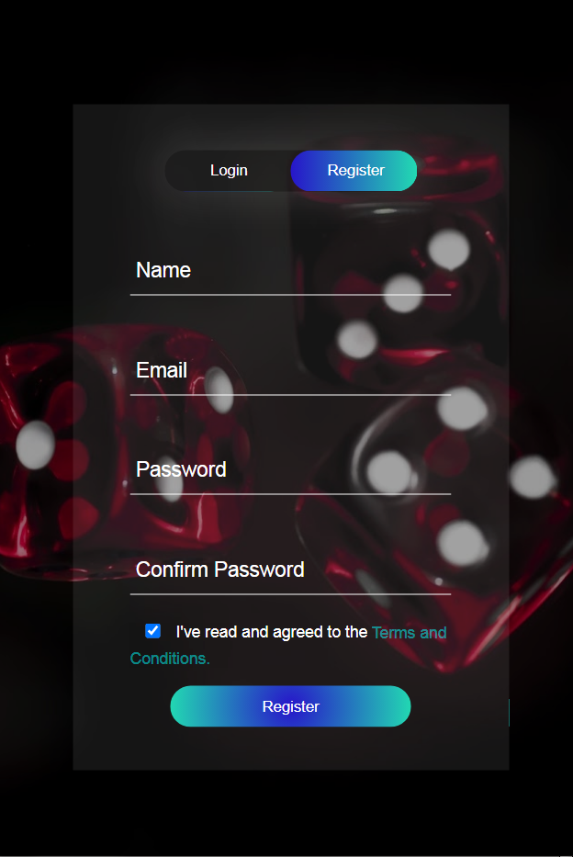
LogIn & Register
Users need to create an account to access our games and music…

Slide 9
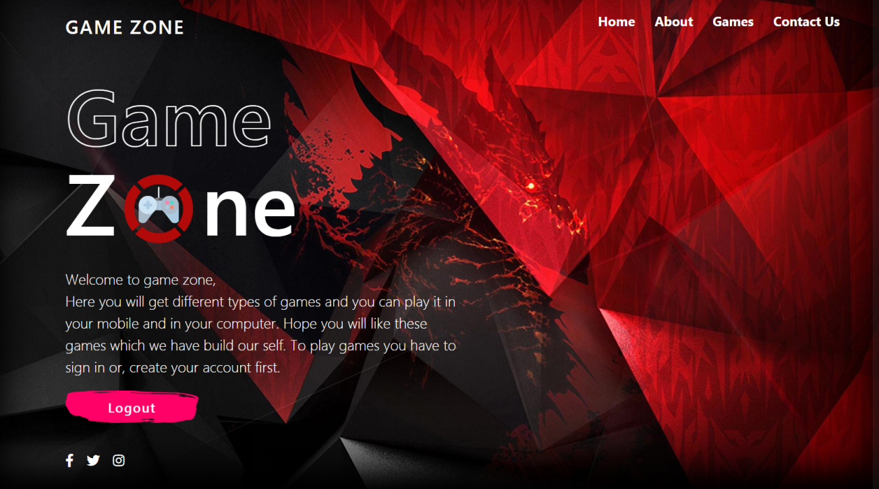
Dashboard Page
After login with Id and Password user can access his dashboard page and their he can play games…

Slide 10
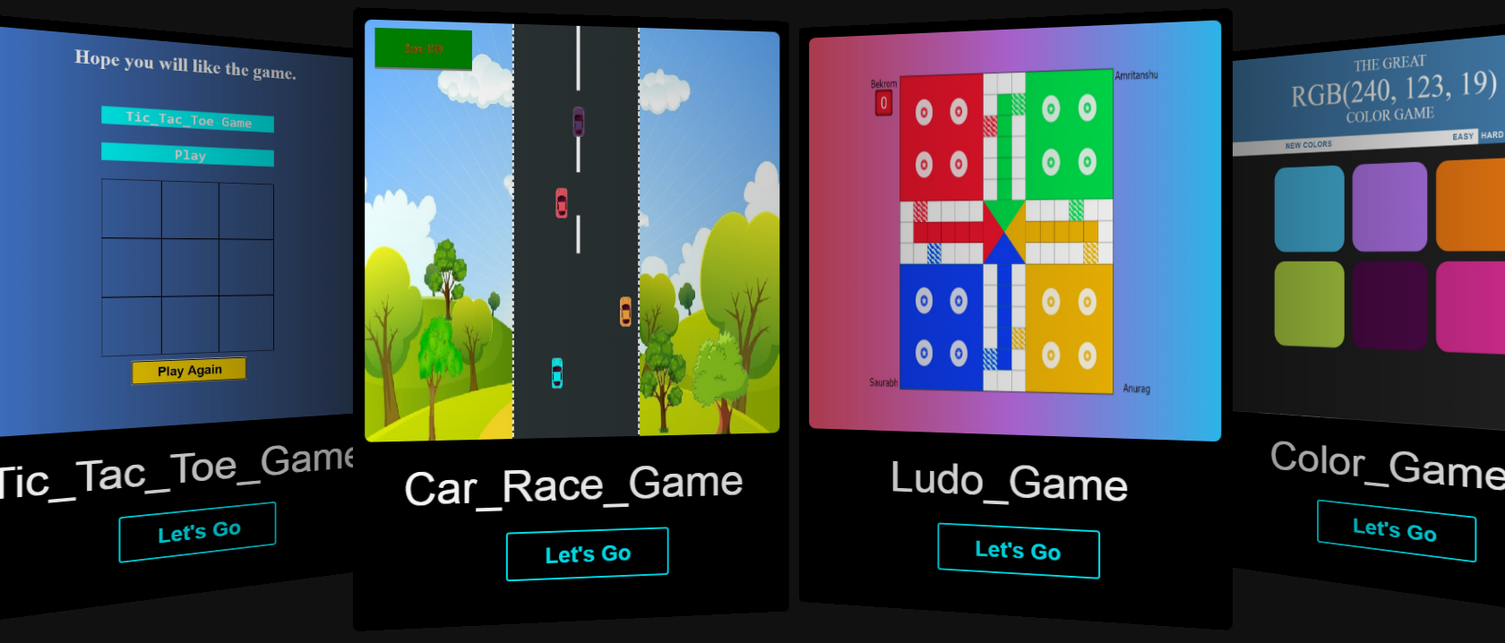
Our Games
Games prepared by our team using HTML, CSS, JAVASCRIPT & PHP are given below.

Slide 11
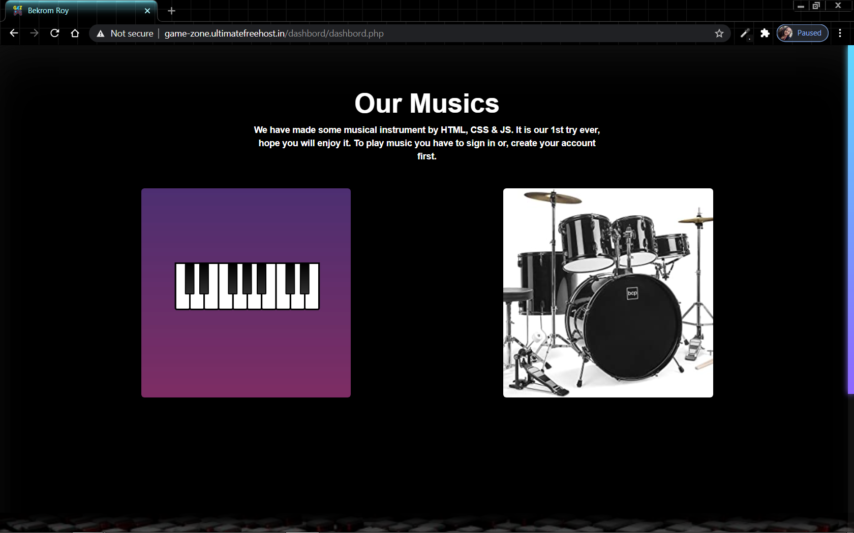
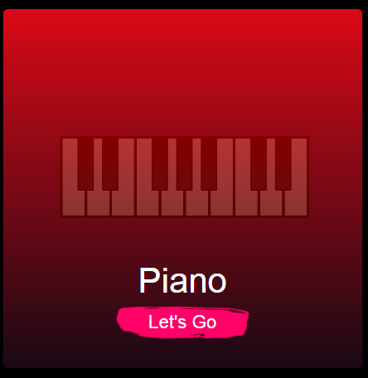
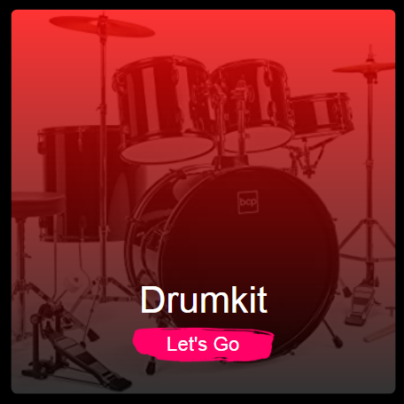
Our Musics
Musics prepared by our team using HTML, CSS, JAVASCRIPT & PHP are given below.

Slide 12
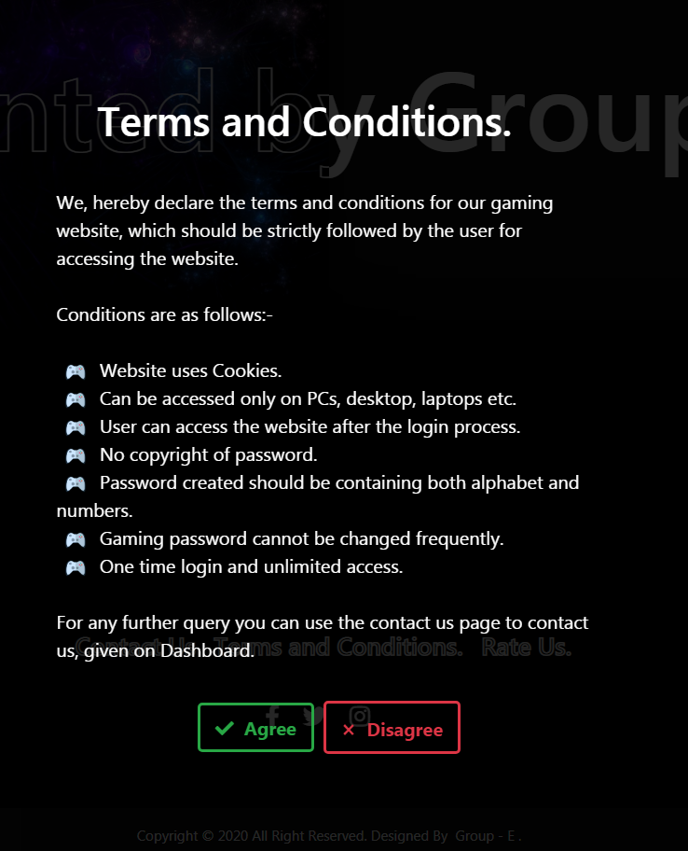
Terms & Conditions
We have added some terms and conditions to maintain our website’s policy…

Slide 13
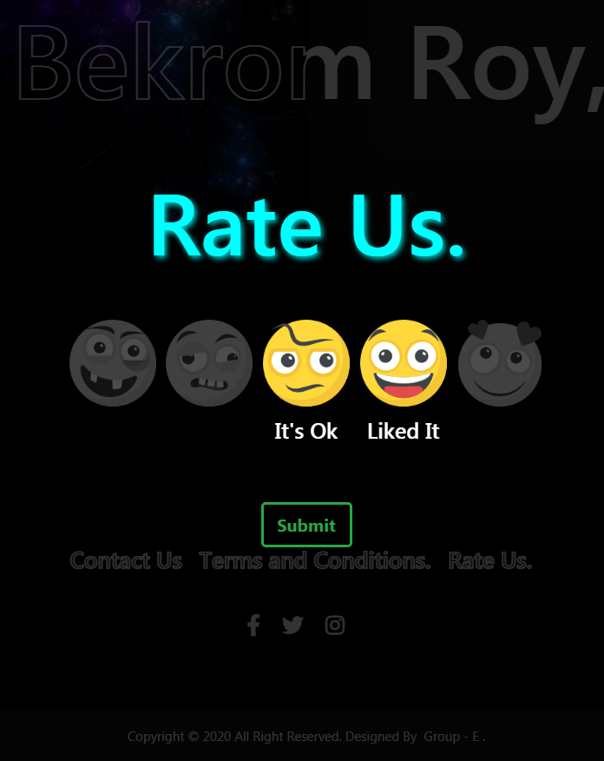
Rate Us
Finally we have made a rate us page to know how much user like our hard work. It is located at the bottom of the page.

Slide 14




CONCLUSION
After the completion of the project we got to know that how can we utilize our programming skills and to work in a team and what are the actual requirements needed to complete website .
And lastly we(Group-E) would like to thank our MD sir (Manash Kr. Deb) for giving us an opportunity to do a project like this and helping us in every step of the project.
Scan to visit our website

Slide 15
THANK YOU

